Slide 1
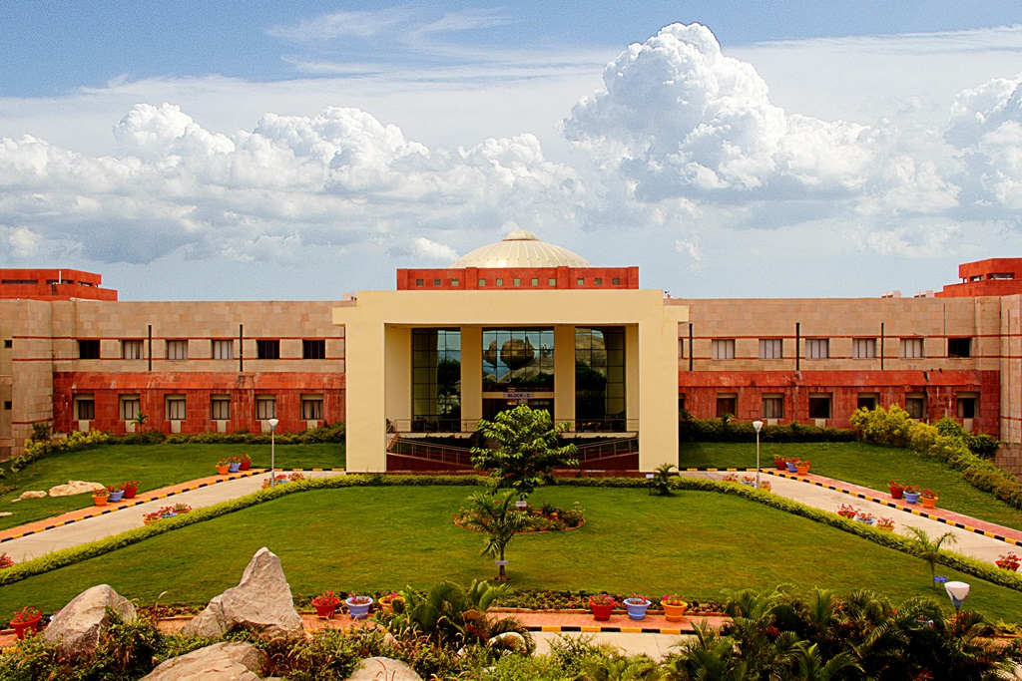

End-Sem Presentation
BITS Pilani
Akash Rajeev, Athul V, Shrinivas Reddy,Vedant Agrawal
Hyderabad Campus

Slide 2
Introduction
Cancer is a term used to describe a group of diseases characterised by abnormal cell proliferation that has the potential to infiltrate or spread to other parts of the body.
Many studies are being carried out in order to detect cancer cells, but the expense of the necessary equipment is prohibitive. Oral cancer is very common in India, accounting for a third of all oral cancer cases worldwide.
After doing basic analysis and studies on different methods for the pre-midsem part we do further analysis and elaboration on different methods.

Slide 3
Fluorescent Sensor
A fluorescent sensor is the complete optical sensing device:
• the light source
• the analyte-responsive (supra)molecular moiety properly immobilized
• the optical system
• the light detector (photomultiplier or photodiode)
• appropriate electronics for displaying the signal.

Slide 4
Working of a PhotoDiode
To comprehend Photodiodes, we must first grasp what a diode is. I won't go into great detail here, but a diode is a component that only enables current to flow in one way ( only in forward bias ). When the current is blocked by a reverse biassed diode.
When it comes to photodiodes, they have the similar property of allowing current to flow when forward biassed. When reverse biassed, however, it resists current until light strikes it. When light strikes a photodiode, current begins to flow through it, which is proportional to the intensity of the incident light. When current passes through the Photodiode, a voltage is created across it, which we will use in our circuit to detect incident light.

Slide 5
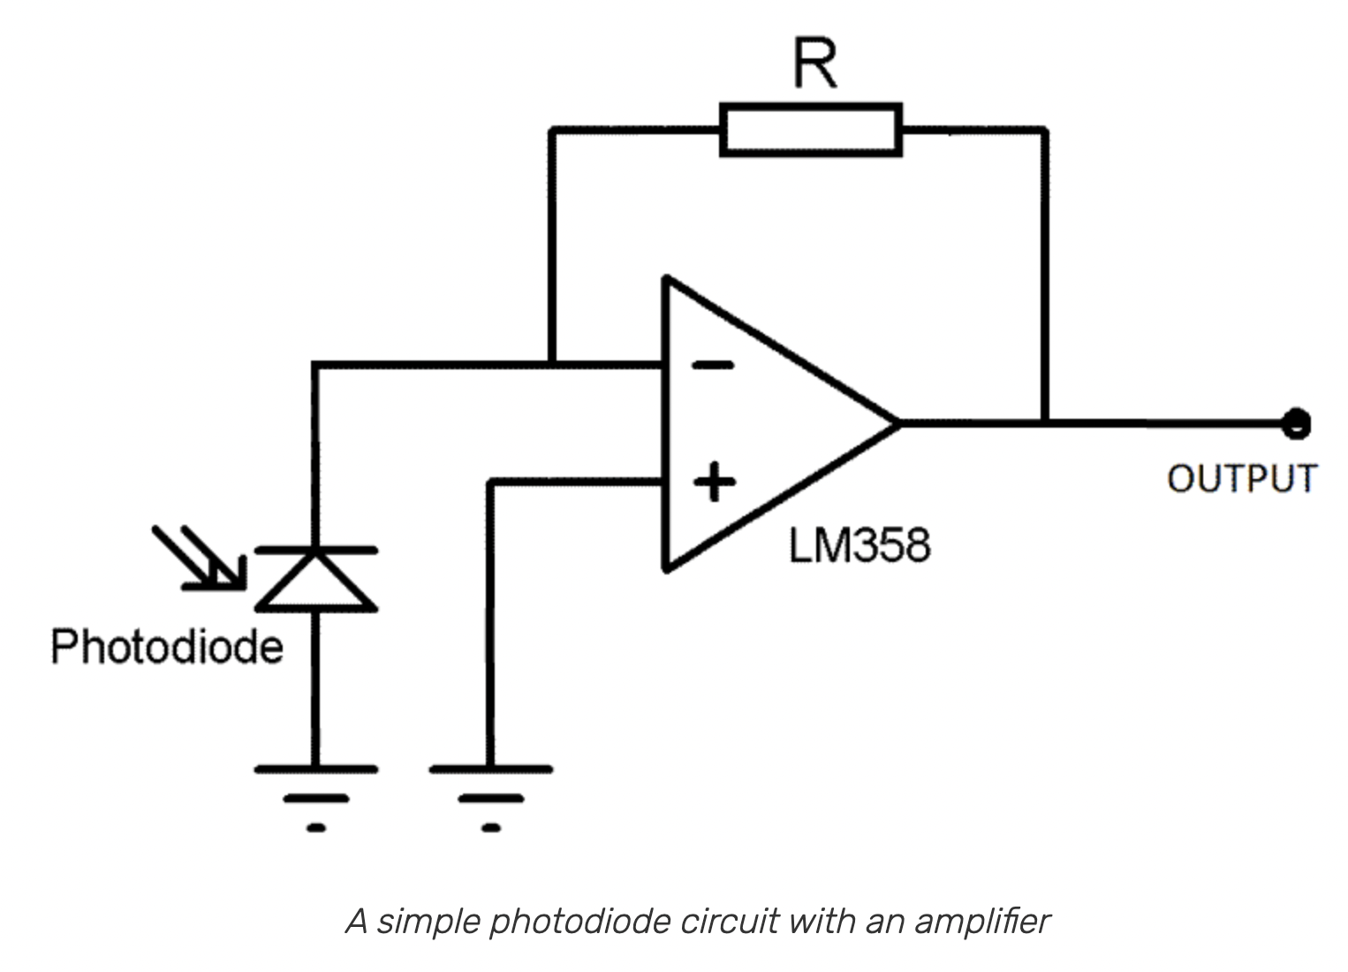
Photodiode Circuit
The cost of making a Photodiode circuit will depend on the following factors :-
The photodiode parameters:
Responsivity:
Saturation current:
Terminal capacitance:
Responsivity temperature coefficient:
Shunt resistance

Slide 6
Pre-midsem part
We studied different methods to diagnose oral cancer such as:
Development of a fluorescent microscope.
Mobile microscopy as a screening tool for oral cancer.
Salivary diagnostics.
Point of care model for diagnostics.

Slide 7
Cons on the present system
Use of single LED type for a specific wavelength binds it to using only one type of dye.
We thought of improving the idea further and use multiple LEDs and have a different mount system altogether.

Slide 8
What is fluorescence, and how do we use it in microscopy
Fluorescence or phosphorescence is the phenomenon which occurs due to absorption of smaller wavelength electromagnetic waves resulting in excitation of electron(s) and subsequent emission of longer wavelength electromagnetic waves due to the vibrational relaxation to its ground state.
It is a form of luminescence and takes place when there is a emission of low energy photon, without a change in the electron spin.
The microscopy takes advantage of it by scanning across a single plane, the fluorescence intensity of cells, tissues, or other intra-cellular structures.
The fluorescence is specifically produced by using a fluorophore (present in the fluorescence dye) to label an antibody, which subsequently targets and attaches to it’s specific antigen in the sample.
Multiple channel method is used for visualization numerous targets in a image, using different antibodies, specific to their non-identical antigens, attached to multi-colored fluorophores having significantly different wavelengths.

Slide 9
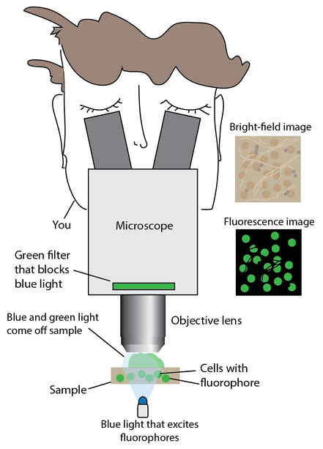
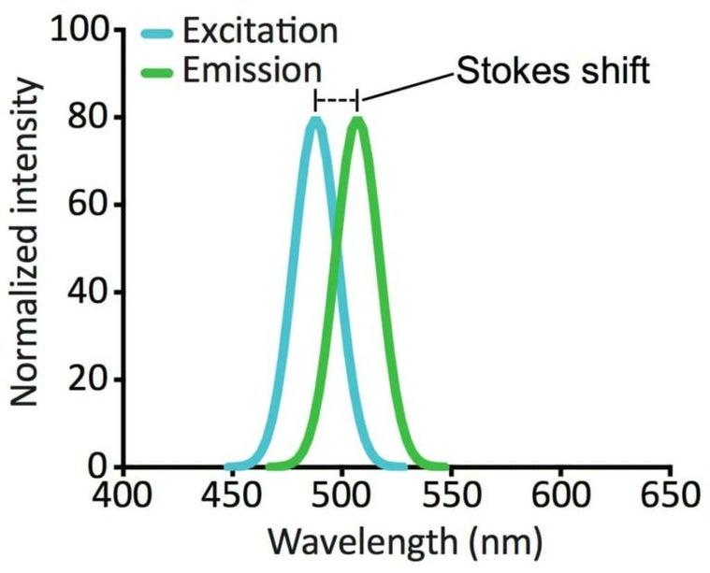

Slide 10
Ray optics and fluorescent microscope, what is the relation
Fluorescence microscopes can be modeled using ray optics.
The fundamental two equations to be used : the thin lens imaging and magnification equations:
1/f = 1/si + 1/so
M = -si/so
The focal length of a lens is denoted by the letter f. A lens with a shorter focal length has better focusing power.
The object distance, or the distance between the lens and the object, is also important (e.g. a tree)
The image distance (si) is the distance between the lens and the point where an image is created.
M stands for magnification.

Slide 11
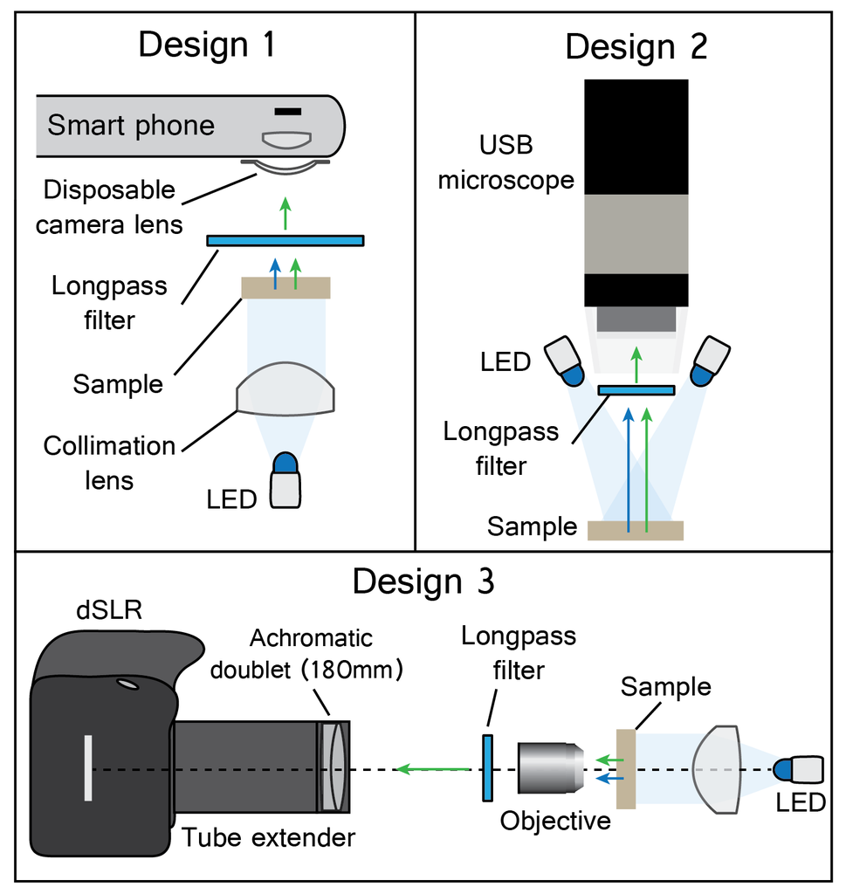
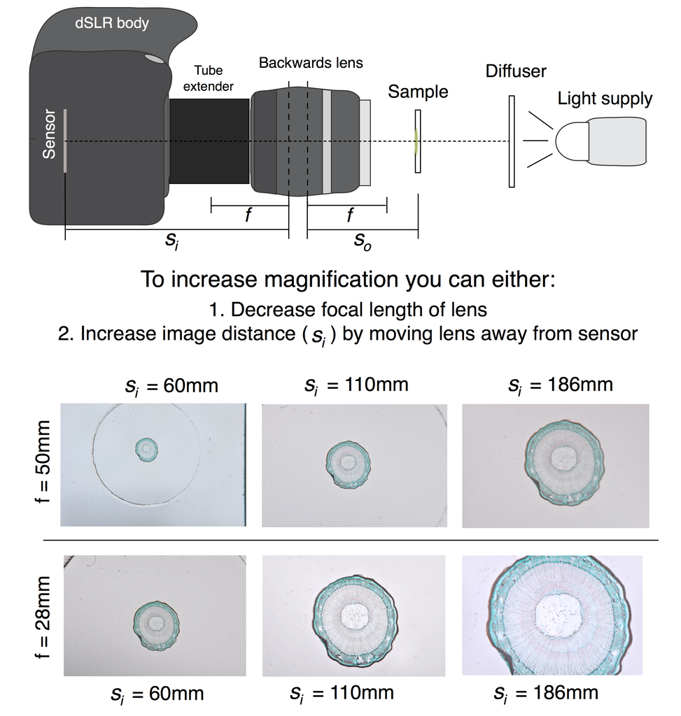

Slide 12
Different dyes for cancer screening
India has one of the highest oral cancer deaths in the country annually. Early detection can help to reduce the mortality of cancer patients and especially for oral potentially malignant disorders (OPMD) and thereby prevent malignant transformation.
There are some dye options which can be usd to stain and then hence detect fluorescence.
These dyes are:-
Fluorescein dye
Methylene blue
Toluidine blue dye
Rhodamine

Slide 13
Comparing the different dyes:
Fluorescein dye has not been explored much yet when it comes for diagnosis of oral cancer while being it has been used before for other tumour detections like breast,brain, colon and stomach.
Tumour biomarkers, saliva based oral cancer diagnostics and fluorescence spectroscopy has been explored before but these types of technologies are very expensive and not feasible for a developing country.
Methylene blue was found to have a sensitivity of 91.4 percent in detecting dysplastic and carcinomatous alterations, a specificity of 66.6 percent, and a positive predictive value of 97.7%.

Slide 14
Fluorescein dye uses:
Fluorescein dye was used and applied to a lesion and then the blue light (480nm) is used to find out the fluorescence and record it in a dark room.
The results showed that 95 % of cancer and dysplasia cases showed fluorescence and also without dysplasia 47.6 % of cases showed fluorescence.
Sensitivity for fluorescein detection method for OPMDs was 96.6%.
The sensitivity of fluorescein was found to be higher than other methods and it was found to be differentiating between non-dysplasia and dysplasia lesions.
It also showed that only 11 % of inflammatory lesions were showing fluorescence.

Slide 15
Results of fluorescein dye study:
The results showed that 95 % of cancer and dysplasia cases showed fluorescence and also without dysplasia 47.6 % of cases showed fluorescence.
Sensitivity for fluorescein detection method for OPMDs was 96.6%.
The sensitivity of fluorescein was found to be higher than other methods and it was found to be differentiating between non-dysplasia and dysplasia lesions.
It also showed that only 11 % of inflammatory lesions were showing fluorescence.
Fluorescein has been showed in various studies to be safe in administration to a large number of patients for dermal use. It is a non toxic and vital dye which in alkaline to slightly acid solutions produces green fluorescence.

Slide 16
Comparing the different dyes
Fluorescein has been showed in various studies to be safe in administration to a large number of patients for dermal use. It is a non toxic and vital dye which in alkaline to slightly acid solutions produces green fluorescence.
Toluidine blue currently has no evidence that it is a cost effective way to be used as a dye for oral cancer screening. The amount of false positives it has makes it a not very suitable dye when it comes to a primary care setting. Using it as a first approach might work but a cost effective tool to be built can be quite difficult.
Rhodamine can be further explored to check its effectiveness when it comes to cancer screening and being used as a dye and fluorescein dye is the only other option which can be compared due to the false negatives of toluidine blue.

Slide 17
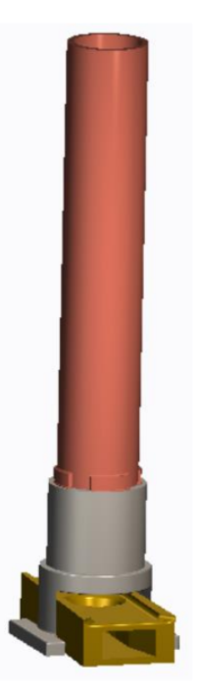
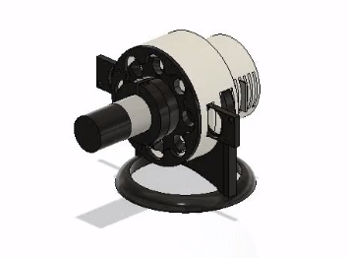
Improvement on the Light Supply
So we took it to ourselves to
build a better prototype
One with multiple LED
Functionality and Lens mount
perfect for phone.
And the source of
illumination is also small.
We have extended by using
multiple LEDs
3D model
Previous Model(Left),Our Model (Right)

Slide 18
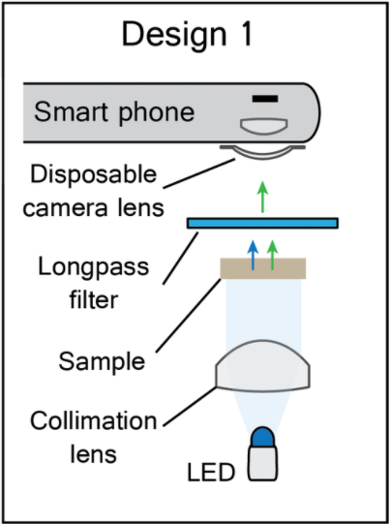
New Prototype Design

Slide 19
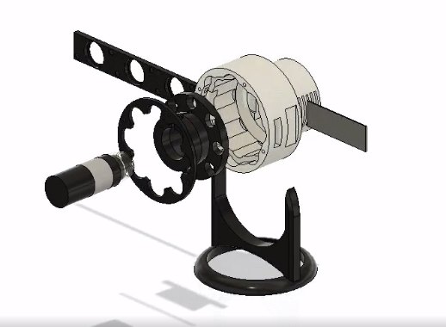
3D Model
Filter
Sample
LED Ligh Mount
Lens

Slide 20
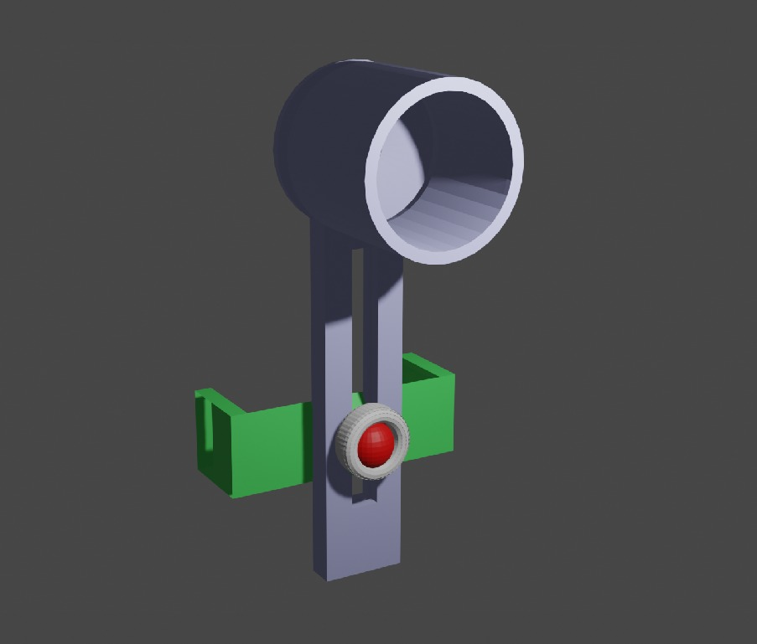
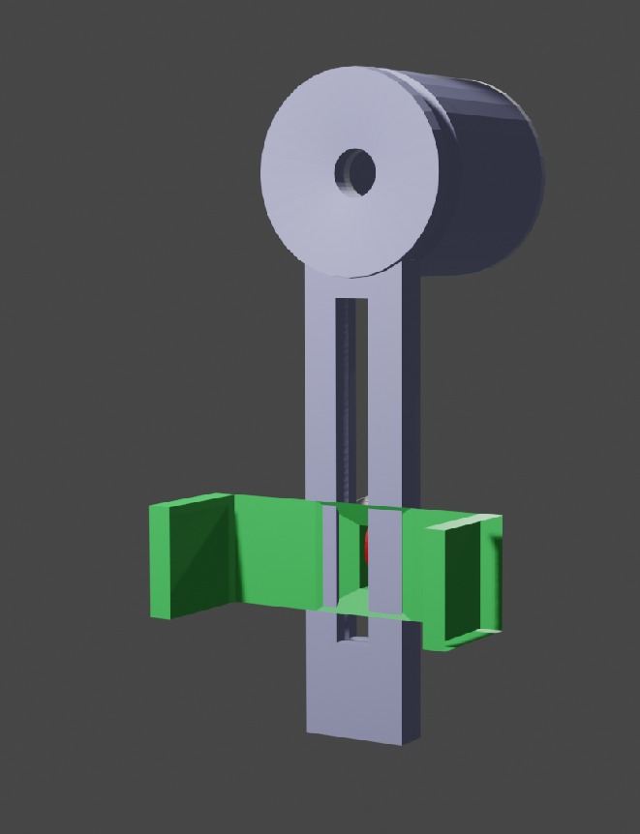

Slide 21
Supplies and Tools
S.No | Supplies | Cost
1 | 3d Printer
2 | Excitation LEDs | 1000-2000 Rupees
3 | Longpass filter | 700 Rupees
4 | Prepared microscope slides | 165 Rupees
5 | Arduino Nano | 400- 500 Rupees
6 | Fluorescent dye | -
7 | Macrolens | 500-1000 Rupees
* | Total | ~ Rupees 2500 Min

Slide 22
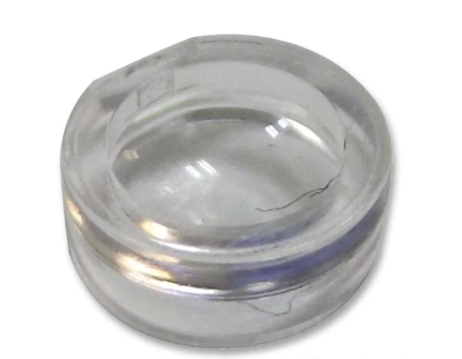
Lazer Lens ~ Collimation lens
~ 500 Rupees

Slide 23
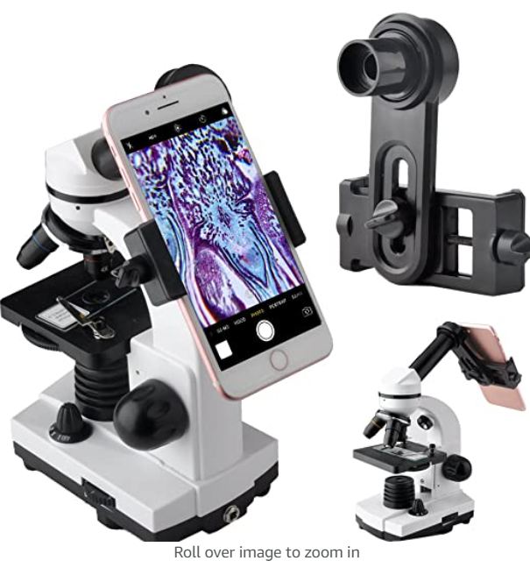
Phone Camera
Build a phone mount for the microscope
Use the phone
camera as sensor…
Everyone has a phone
today
Cost - Nil
3d model a mount for
keeping the phone

Slide 24
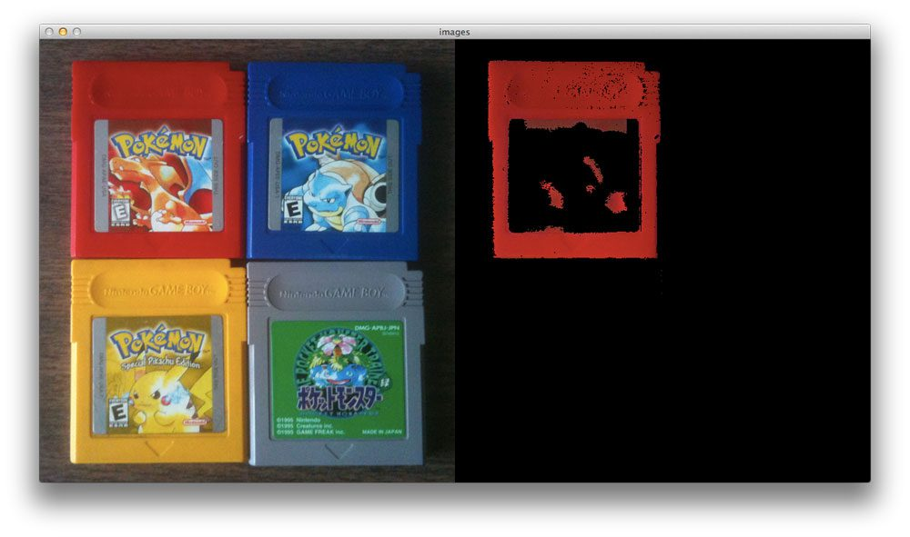
Detecting Specific Wavelengths of Light using phone camera and OpenCV

Slide 25
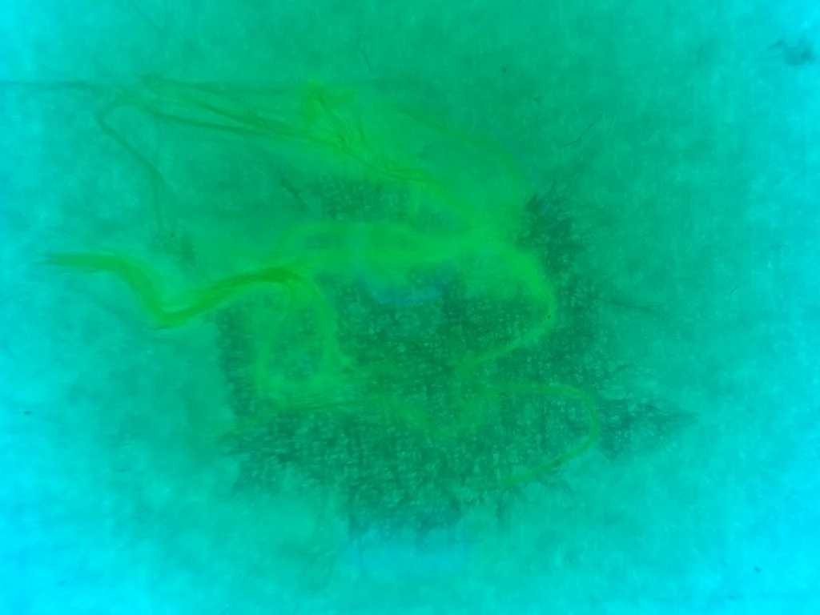
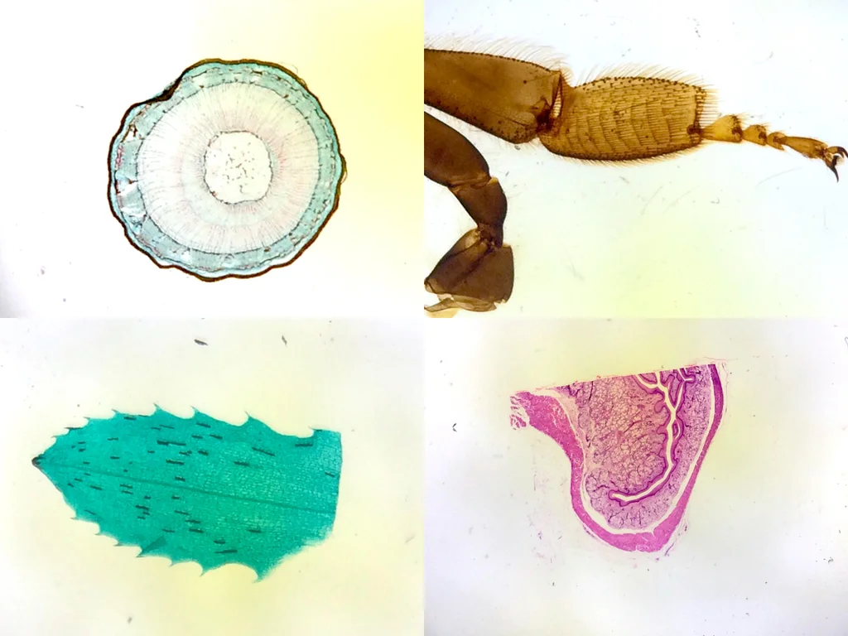
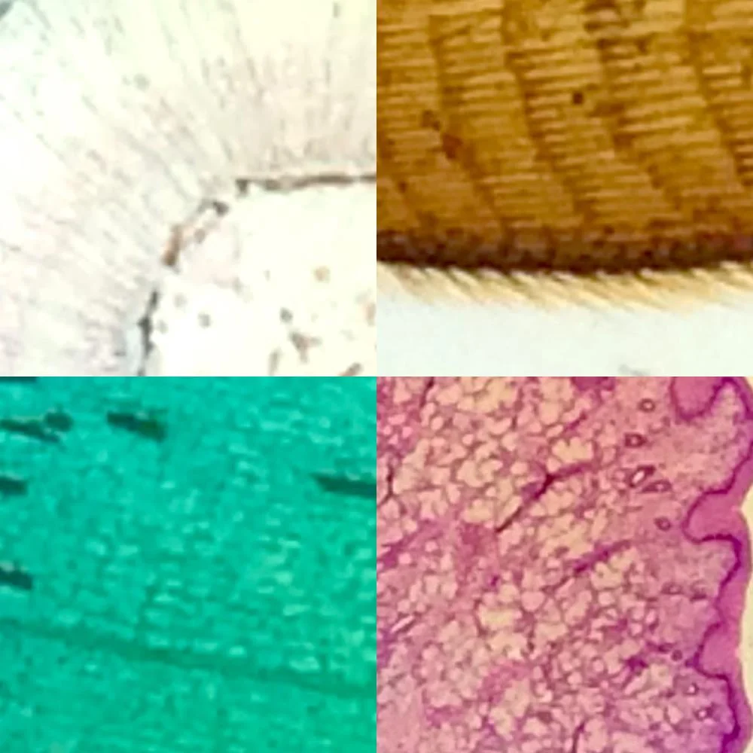
Macrolens Images

Slide 26
References
Riaz A, Shreedhar B, Kamboj M, Natarajan S. Methylene blue as an early diagnostic marker for oral precancer and cancer. Springerplus. 2013 Dec;2(1):95. doi: 10.1186/2193-1801-2-95. Epub 2013 Mar 9. PMID: 23524482; PMCID: PMC3602613.
Riaz, A., Shreedhar, B., Kamboj, M., & Natarajan, S. (2013). Methylene blue as an early diagnostic marker for oral precancer and cancer. SpringerPlus, 2(1), 95. https://doi.org/10.1186/2193-1801-2-95
Riaz, Akhtar et al. “Methylene blue as an early diagnostic marker for oral precancer and cancer.” SpringerPlus vol. 2,1 (2013): 95. doi:10.1186/2193-1801-2-95
Riaz A, Shreedhar B, Kamboj M, Natarajan S. Methylene blue as an early diagnostic marker for oral precancer and cancer. Springerplus. 2013;2(1):95. doi:10.1186/2193-1801-2-95
Gray M, Gold L, Burls A, Elley K, House K, Bromwich W, Bosworth M. The clinical effectiveness of toluidine blue dye as an adjunct to oral cancer screening in general dental practice. A West Midlands Development and Evaluation Service Report. 2000 Dec;2000:57.
Gray, M., Gold, L., Burls, A., Elley, K., House, K., Bromwich, W., & Bosworth, M. (2000). The clinical effectiveness of toluidine blue dye as an adjunct to oral cancer screening in general dental practice. A West Midlands Development and Evaluation Service Report, 2000, 57.
Jeremy D. Meier, D. Gregory Farwell, Yinghua Sun, Jennifer Phipps, Nisa Hatami, Laura Marcu, Yang Sun, Fluorescence lifetime imaging microscopy in oral cancer, Otolaryngology - Head and Neck Surgery, Volume 141, Issue 3, Supplement 1, 2009, Page P51, ISSN 0194-5998, https://doi.org/10.1016/j.otohns.2009.06.153.

Slide 27
Thank You
Respected Faculty

